Slide 1
Virtual Memory
Yoav Etsion

Slide 2
Virtual memory recap
Virtual memory is a great abstraction for decoupling program view of memory from the physical view
Simplified isolation between applications
Allows OS to manage physical memory without affecting program correctness
Provides programmers with an abstract view of memory
Virtual memory translation has become terrible for performance
Translation times, esp. in virtual systems, are a major run time overhead
Hardware countermeasures impose area and power overheads
Size of caches (100 MBs) and physical memory (TBs) is increasing

Slide 3
Virtual memory recap
Linear Address Space (4K Page)
63
47
39
38
30
29
21
20
12
11
0
Radix tree page tables on x86_64 for 4KB pages
sign ext.
PML4
PDP
DIR
TABLE
OFFSET
9
9
9
9
12
4KByte Frame
data
512 entry Page Directory
Pointer Table
512 entry
Page Directory
512 entry Page Table
512 entry PML4 Table
PTE
28
PDE
PDP entry
28
PML4 entry
28
28
40 (4KB aligned)
CR3 (PDPTR)

Slide 4
Virtual memory recap
Linear Address Space (2M Page)
63
47
39
38
30
29
21
20
0
Radix tree page tables on x86_64 for 2MB pages
sign ext.
PML4
PDP
DIR
OFFSET
9
9
9
21
2MByte Frame
512 entry Page Directory
Pointer Table
512 entry
Page Directory
data
512 entry PML4 Table
PDE
PDP entry
19
PML4 entry
28
28
40 (4KB aligned)
CR3 (PDPTR)

Slide 5
Virtual memory recap
Page tables reside in memory
Each translation requires multiple memory accesses
Typically, more than once
Might be required for each load/store!
Translation lookaside buffer (TLB)
Hardware cache for recently used PTEs (locality)
Speeds up translation
Fewer than 100 entries
Modern CPUs have L2 TLB as well
2 to 8 way associative
TLB access time is faster than L1 cache access time
Virtual Address
TLB Access
Access
Page Table
No
TLB Hit ?
Yes
Physical
Addresses

Slide 6
TLBs: Single core
Thread accesses VA₁
CPU₁
TLB
L1
L2
LLC

Slide 7
TLBs: Single core
Thread accesses VA₁
TLB caches mapping
CPU₁
TLB
VA₁->PA₁
L1
L2
LLC

Slide 8
TLBs: Single core
Thread accesses VA₁
TLB caches mapping
Thread frees memory
munmap, not just free
CPU₁
TLB
VA₁->PA₁
L1
L2
LLC

Slide 9
TLBs: Single core
Thread accesses VA₁
TLB caches mapping
Thread frees memory
munmap, not just free
OS flushes mapping from TLB
CPU₁
TLB
VA₁->PA₁
L1
L2
LLC

Slide 10
TLBs: Single core
Thread accesses VA₁
TLB caches mapping
Thread frees memory
munmap, not just free
OS flushes mapping from TLB
CPU₁
TLB
L1
L2
LLC

Slide 11
TLBs: Single core
Thread accesses VA₁
TLB caches mapping
Thread frees memory
munmap, not just free
OS flushes mapping from TLB
All is well ☺
CPU₁
TLB
L1
L2
LLC

Slide 12
TLBs: Multicore
Thread₁ accesses VA₁
CPU₁
CPU₂
TLB
VA₁->PA₁
TLB
L1
L1
L2
L2
LLC

Slide 13
TLBs: Multicore
Thread₁ accesses VA₁
Thread₂ accesses VA₁ on a different core
Different or migrated thread
CPU₁
CPU₂
TLB
VA₁->PA₁
VA₁->PA₁
TLB
L1
L1
L2
L2
LLC

Slide 14
TLBs: Multicore
Thread₁ accesses VA₁
Thread₂ accesses VA₁ on a different core
Different or migrated thread
Thread₁ unmaps memory
Using munmap, not just free (free returns buffer to malloc poll)
CPU₁
CPU₂
TLB
VA₁->PA₁
VA₁->PA₁
TLB
L1
L1
L2
L2
LLC

Slide 15
TLBs: Multicore
Thread₁ accesses VA₁
Thread₂ accesses VA₁ on a different core
Different or migrated thread
Thread₁ unmaps memory
Using munmap, not just free (free returns buffer to malloc poll)
OS flushes mapping from TLB
CPU₁
CPU₂
TLB
VA₁->PA₁
VA₁->PA₁
TLB
L1
L1
L2
L2
LLC

Slide 16
TLBs: Multicore
Thread₁ accesses VA₁
Thread₂ accesses VA₁ on a different core
Different or migrated thread
Thread₁ unmaps memory
Using munmap, not just free (free returns buffer to malloc poll)
OS flushes mapping from TLB
CPU₁
CPU₂
TLB
VA₁->PA₁
TLB
L1
L1
L2
L2
LLC

Slide 17
TLBs: Multicore
Thread₁ accesses VA₁
Thread₂ accesses VA₁ on a different core
Different or migrated thread
Thread₁ unmaps memory
Using munmap, not just free (free returns buffer to malloc poll)
OS flushes mapping from TLB
See the problem?
CPU₁
CPU₂
TLB
VA₁->PA₁
TLB
L1
L1
L2
L2
LLC

Slide 18
TLBs: Multicore
Thread accesses VA₁
Thread accesses VA₁ a different core
Different or migrated thread
Thread frees memory
munmap, not just free
OS flushes mapping from TLB
See the problem?
A TLB holds a stale mapping
Correctness & security issue
CPU₁
CPU₂
TLB
VA₁->PA₁
TLB
L1
L1
L2
L2
LLC

Slide 19
The TLB coherence problem
Hardware does not enforce coherence across TLBs
Although research showed the benefits
E.g.,
Romanescu et al., "UNified Instruction/Translation/Data (UNITD) coherence: One protocol to rule them all“. In HPCA 2010
Villavieja et al., "DiDi: Mitigating the Performance Impact of TLB Shootdowns Using a Shared TLB Directory“. In PACT 2011

Slide 20
The TLB coherence problem
Hardware does not enforce coherence across TLBs
Although research showed the benefits
E.g.,
Romanescu et al., "UNified Instruction/Translation/Data (UNITD) coherence: One protocol to rule them all“. In HPCA 2010
Villavieja et al., "DiDi: Mitigating the Performance Impact of TLB Shootdowns Using a Shared TLB Directory“. In PACT 2011
But OS frequently needs to unmap pages and change translations
Free memory, move pages, change page permissions, swapping, etc.

Slide 21
The TLB coherence problem
Hardware does not enforce coherence across TLBs
Although research showed the benefits
E.g.,
Romanescu et al., "UNified Instruction/Translation/Data (UNITD) coherence: One protocol to rule them all“. In HPCA 2010
Villavieja et al., "DiDi: Mitigating the Performance Impact of TLB Shootdowns Using a Shared TLB Directory“. In PACT 2011
But OS frequently needs to unmap pages and change translations
Free memory, move pages, change page permissions, swapping, etc.
How do we make TLBs coherent using today’s hardware?

Slide 22
TLB shootdown

Slide 23
TLB shootdown
Thread₁ frees memory
munmap, not just free
CPU₁
CPU₂
TLB
VA₁->PA₁
VA₁->PA₁
TLB
L1
L1
L2
L2
LLC

Slide 24
TLB shootdown
Thread₁ frees memory
munmap, not just free
OS on CPU₁:
Locks entry in page table
CPU₁
CPU₂
TLB
VA₁->PA₁
VA₁->PA₁
TLB
L1
Page Table
L1
L2
L2
LLC

Slide 25
TLB shootdown
Thread₁ frees memory
munmap, not just free
OS on CPU₁:
Locks entry in page table
Sends inter-processor interrupt (IPI) to other CPUs
CPU₁
CPU₂
TLB
VA₁->PA₁
VA₁->PA₁
TLB
L1
Page Table
L1
L2
L2
LLC

Slide 26
TLB shootdown
Thread₁ frees memory
munmap, not just free
OS on CPU₁:
Locks entry in page table
Sends inter-processor interrupt (IPI) to other CPUs
(Other CPUs invoke SW handler and flush mapping from TLB)
CPU₁
CPU₂
TLB
VA₁->PA₁
VA₁->PA₁
TLB
L1
Page Table
L1
L2
L2
LLC

Slide 27
TLB shootdown
Thread₁ frees memory
munmap, not just free
OS on CPU₁:
Locks entry in page table
Sends inter-processor interrupt (IPI) to other CPUs
(Other CPUs invoke SW handler and flush mapping from TLB)
(Other CPUs ack CPU₁)
CPU₁
CPU₂
TLB
VA₁->PA₁
TLB
L1
Page Table
L1
L2
L2
LLC

Slide 28
TLB shootdown
Thread₁ frees memory
munmap, not just free
OS on CPU₁:
Locks entry in page table
Sends inter-processor interrupt (IPI) to other CPUs
(Other CPUs invoke SW handler and flush mapping from TLB)
(Other CPUs ack CPU₁)
Flushes mapping in CPU₁
CPU₁
CPU₂
TLB
VA₁->PA₁
TLB
L1
Page Table
L1
L2
L2
LLC

Slide 29
TLB shootdown
Thread₁ frees memory
munmap, not just free
OS on CPU₁:
Locks entry in page table
Sends inter-processor interrupt (IPI) to other CPUs
(Other CPUs invoke SW handler and flush mapping from TLB)
(Other CPUs ack CPU₁)
Flushes mapping in CPU₁
CPU₁
CPU₂
TLB
TLB
L1
Page Table
L1
L2
L2
LLC

Slide 30
TLB shootdown
Thread₁ frees memory
munmap, not just free
OS on CPU₁:
Locks entry in page table
Sends inter-processor interrupt (IPI) to other CPUs
(Other CPUs invoke SW handler and flush mapping from TLB)
(Other CPUs ack CPU₁)
Flushes mapping in CPU₁
Unlocks entry in page table
CPU₁
CPU₂
TLB
TLB
L1
Page Table
L1
L2
L2
LLC

Slide 31
TLB shootdown
Thread₁ frees memory
munmap, not just free
OS on CPU₁:
Locks entry in page table
Sends inter-processor interrupt (IPI) to other CPUs
(Other CPUs invoke SW handler and flush mapping from TLB)
(Other CPUs ack CPU₁)
Flushes mapping in CPU₁
Unlocks entry in page table
Resumes execution
CPU₁
CPU₂
TLB
TLB
L1
Page Table
L1
L2
L2
LLC

Slide 32
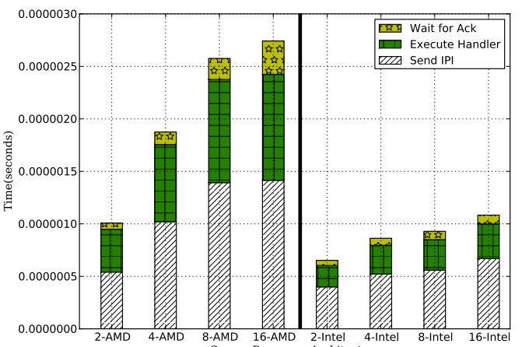
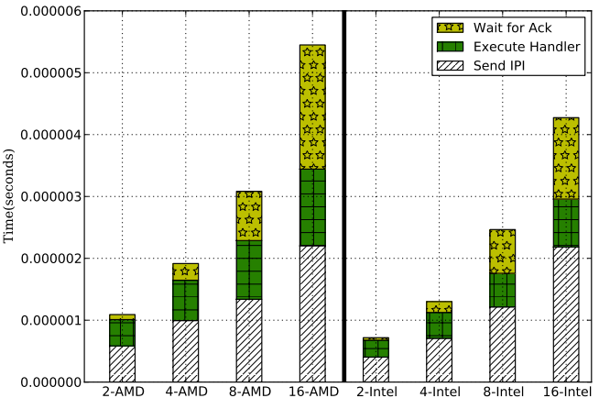
TLB shootdown: The overhead
TLB shootdowns are a real pain
Example overheads from DiDi paper: Can reach over 5us
Apache Web Server
Word Count

Slide 33
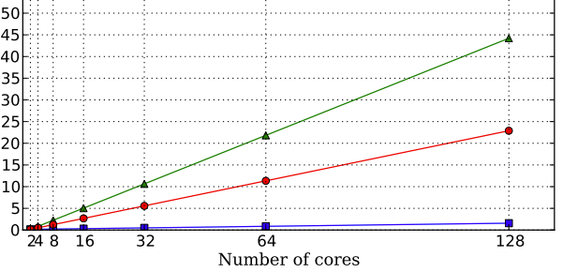

TLB shootdown: The overhead
The real factor is shootdown frequency
Shootdown frequency increases with:
Core count
Multiprogramming environments (e.g., cloud)
Example from the DiDi paper
Based on a model extrapolated from real systems
Back in 2011 we had fewer cores
Later validated by others

Slide 34
TLB shootdown: HW/SW co-designs
Modern processors still don’t offer full TLB coherence
I don’t really know why
But big vendors introduced some HW support in recent years
Intel RAR (Remote Action Request)
AMD INVLPGB

Slide 35
TLB shootdown: Intel RAR
Introduced in 2021
Avoids interrupting remote cores

Slide 36
TLB shootdown: Intel RAR
Thread frees memory
munmap, not just free
OS on CPU₁:
Locks entry in page table
Sends inter-processor interrupt (IPI) to other CPUs
(Other CPUs invoke SW handler and flush mapping from TLB)
CPU₁
CPU₂
TLB
VA₁->PA₁
VA₁->PA₁
TLB
L1
Page Table
L1
L2
L2
LLC

Slide 37
TLB shootdown
Thread frees memory
munmap, not just free
OS on CPU₁:
Locks entry in page table
Sends inter-processor interrupt (IPI) to other CPUs
(Other CPUs invoke SW handler and flush mapping from TLB)
CPU₁
CPU₂
TLB
VA₁->PA₁
VA₁->PA₁
TLB
L1
Page Table
L1
L2
L2
LLC

Slide 38
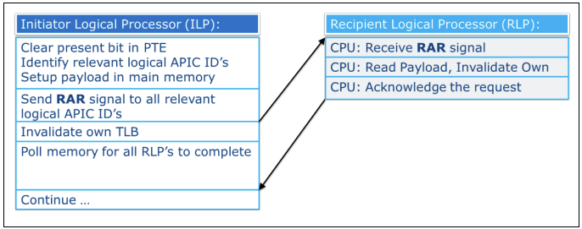
TLB shootdown: Intel RAR
Introduced in 2021
Avoids interrupting remote cores
Intel Remote Action Request: White Paper, July 2021

Slide 39
TLB shootdown: Intel RAR
Introduced in 2021
Avoids interrupting remote cores
Not yet supported in official Linux kernel
Beta code not stable yet
My take:
Sounds like interrupt handling takes place in microcode
Saves the need to invoke handler and save/restore running thread
Minimal hardware intervention, but also minimal performance gains

Slide 40
TLB shootdown: AMD INVLPGB
Introduced in late 2002
INVLPGB instruction broadcasts and invalidation request to all cores
Supports multiple in-flight requests
TLBSYNC instruction waits for all pending requests

Slide 41
TLB shootdown
Thread frees memory
munmap, not just free
OS on CPU₁:
Locks entry in page table
INVLPGB broadcasts invalidations to all TLBs
TLBSYNC waits for invalidations to complete
CPU₁
CPU₂
TLB
VA₁->PA₁
VA₁->PA₁
TLB
L1
Page Table
L1
L2
L2
LLC

Slide 42
TLB shootdown: AMD INVLPGB
Introduced in late 2020
INVLPGB instruction broadcasts and invalidation request to all cores
Supports multiple in-flight requests
TLBSYNC instruction waits for all pending requests
Integrated into Linux kernel in March 2025
Kernel mailing lists reports 2x speedup compared to SW-based shootdown
My student Gal Dvir measured ~0.5us overhead
My take:
Seems like a more extensive solution than Intel RAR
Possibly implemented in microcode(?)

Slide 43
TLB shootdown: Summary
A real problem in modern CPUs
Identified in academia ~15 years ago
Took industry ~10 years to provide a partial solution
Took another ~5 years to integrate into mainline kernel
Part of a bigger problem:
Virtual memory (and other HW/SW abstractions) designed in simpler times
Not a good fit for modern workloads running on manycore CPUs
We need to rethink these abstractions

Slide 44
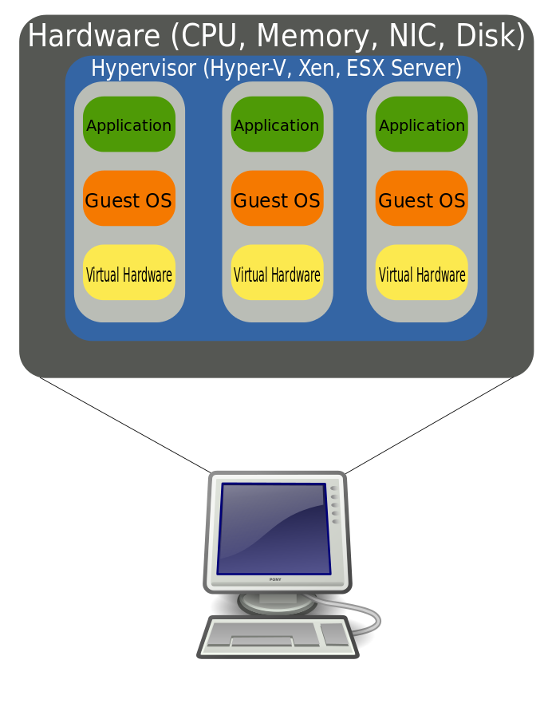
Nested virtual memory translation
Virtual machines are common in cloud environments
We already discussed some of the virtualization overheads
Let’s examine the impact on virtual memory

Slide 45
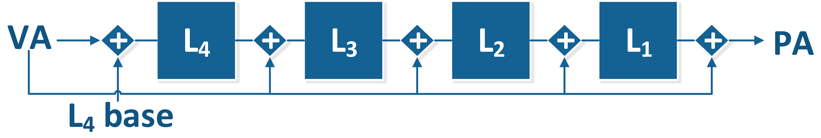
Nested virtual memory translation
Each virtual machine “thinks” it is managing its own memory
The guest OS manages page tables for all processes
Guest “thinks” translation is done by computing a sequence of physical addresses:

Slide 46
Nested virtual memory translation
The host must virtualize the memory translation for the guest
What guest sees as physical, host sees as virtual
Each “physical” address in the guest is a virtual address in the host
We now have four types of addresses
gVA (guest virtual address)
gPA (guest physical address)
hVA (host virtual address; typically =gPA)
hPA (host physical address)
Each step of traversing the guest page table requires a gPA -> hPA translation

Slide 47
Nested page-walk
From 1D page walk to a 2D page-walk

Slide 48
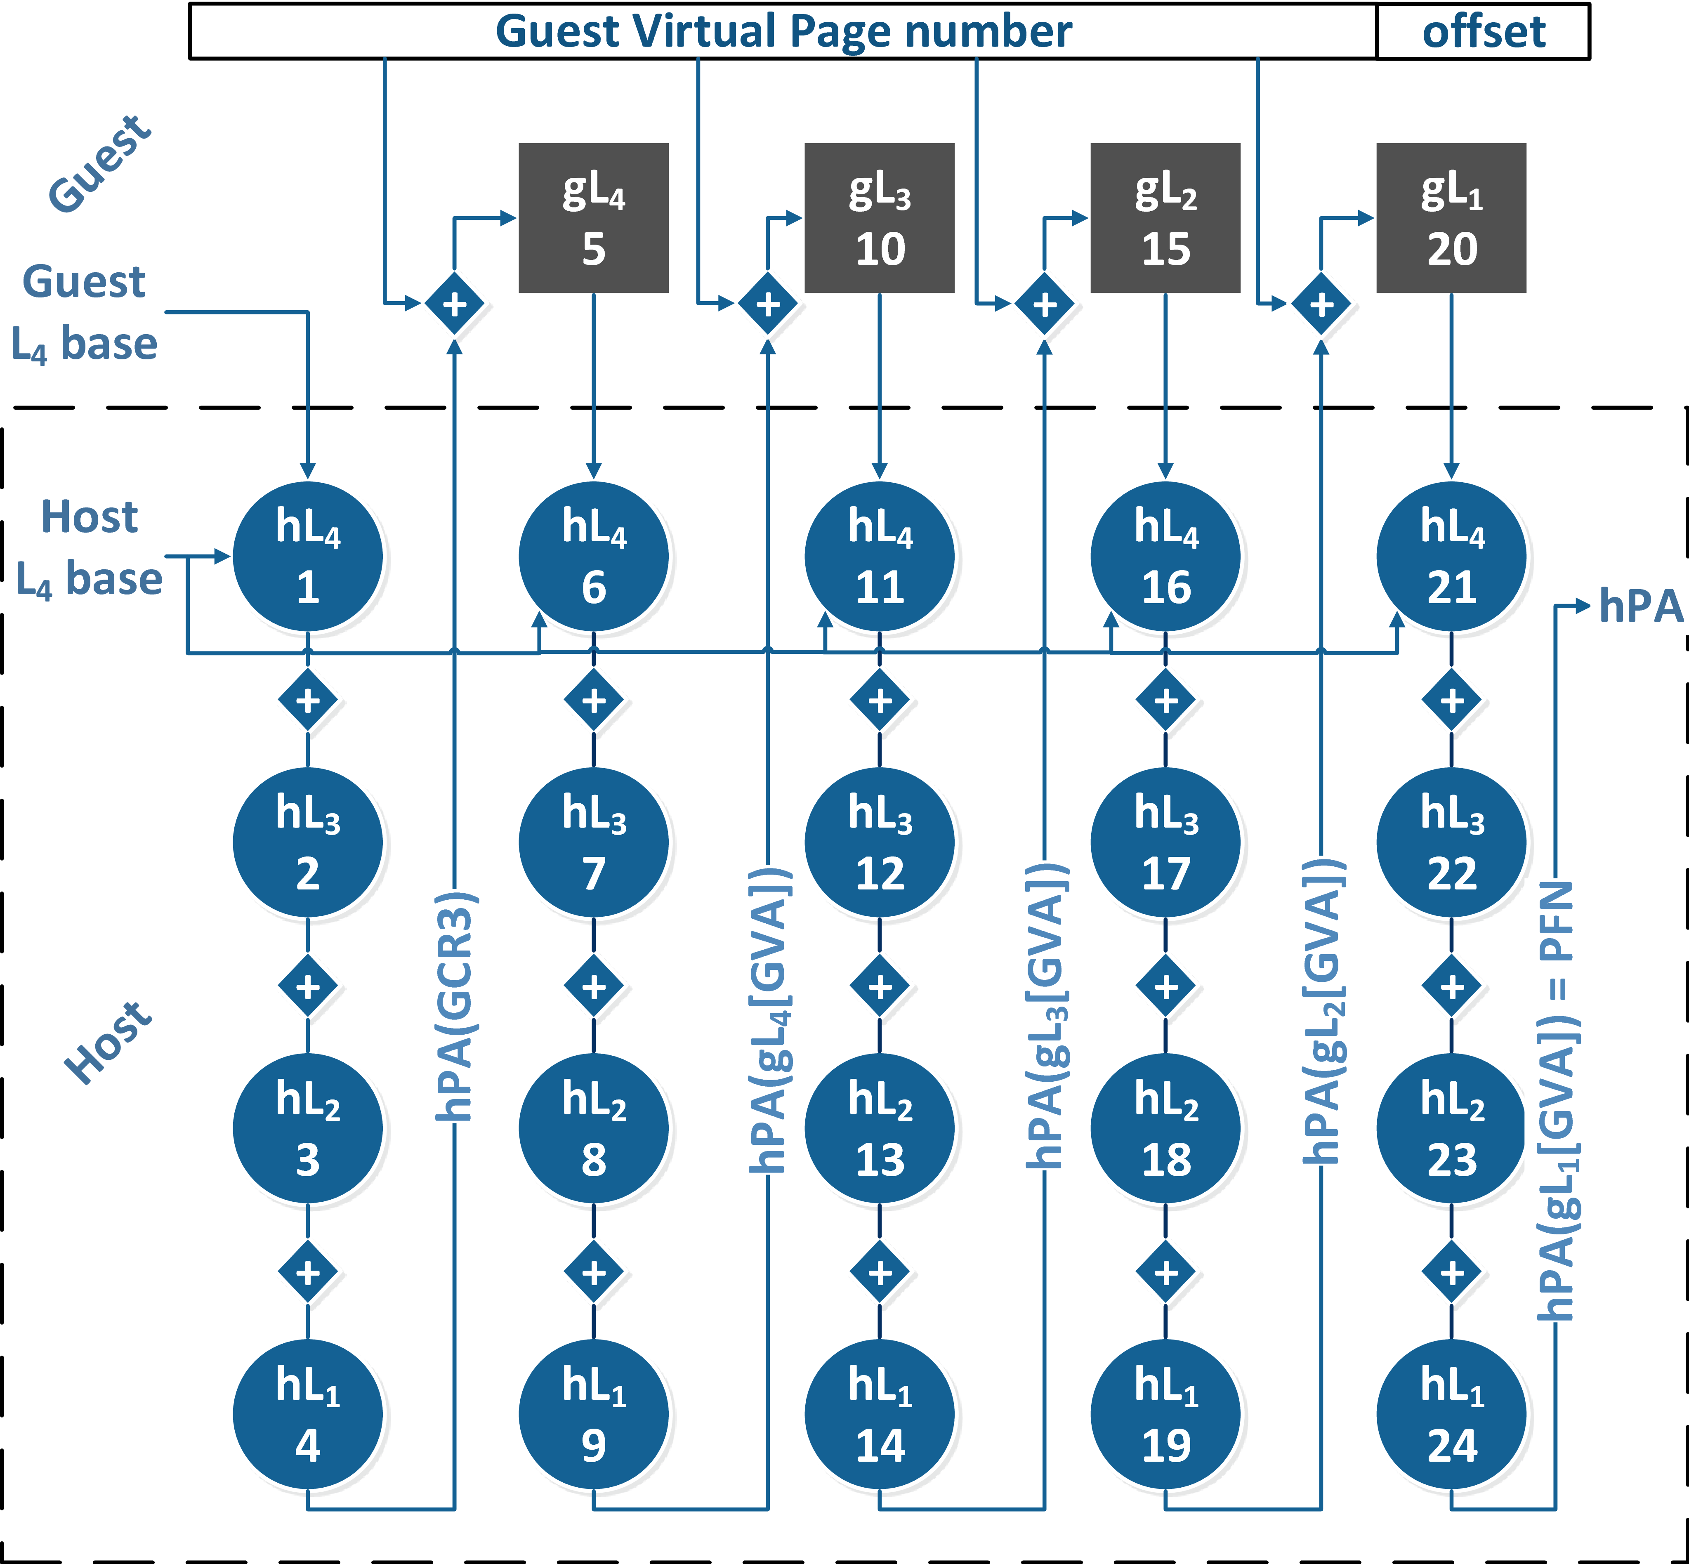
Nested page-walk
Page table base: gPA
Guest uses gPAs in its page table
Host must translate each gPA to a hPA

Slide 49
Nested page-walk
Also called 2D address translation
Hypervisor provides a page table for each virtual machine
Hardware performs the double translation:
Overhead: A gVA -> hPA translation may cost 24 memory accesses!

Slide 50
Nested page-walk: Partial Walk Caches (PwC)
9b
9b
9b
9b
PwCs cache partial translations to shorten the walk
Use address prefixes to get to guest page table entries

Slide 51
Nested page-walk: Partial Walk Caches (PwC)
9b
9b
9b
9b
Index
PwCs cache partial translations to shorten the walk
Use address prefixes to get to guest page table entries

Slide 52
Nested page-walk: Partial Walk Caches (PwC)
9b
9b
9b
9b
Index
PwCs cache partial translations to shorten the walk
Use address prefixes to get to guest page table entries

Slide 53
Nested page-walk: Partial Walk Caches (PwC)
9b
9b
9b
9b
Index
PwCs cache partial translations to shorten the walk
Use address prefixes to get to guest page table entries

Slide 54
Nested page-walk: Partial Walk Caches (PwC)
9b
9b
9b
9b
Index
PwCs cache partial translations to shorten the walk
Use address prefixes to get to guest page table entries
All PwCs are searched in parallel
More power, on top of area

Slide 55
Nested Page Walks: What can we do?
Active research topic
But no canonical solutions yet
Data centers have to do with what hardware provides…

Slide 56
Nested page-walk in data centers
Page table base: gPA
Data centers use 1GB pages in hypervisors
Pros:
shortens walk to 15 mem. Accesses
Cons:
Moving/swapping 1GB pages takes more time
1GB pages
2MB pages
4KB pages

Slide 57
Nested page-walk: Overheads
Two seminal papers that introduced the overheads
Basu et al., “Efficient virtual memory for big memory servers”. In ISCA 2013
Alam et al., “Do-It-Yourself Virtual Memory Translation”. In ISCA 2017
Very different proposals that target the same problem
Not the only proposals…

Slide 58
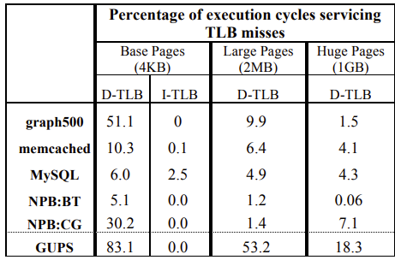
Nested page-walk: Skip translation (Basu’13)
Observation: The overheads of TLB misses is staggering for 4KB and 2MB pages

Slide 59
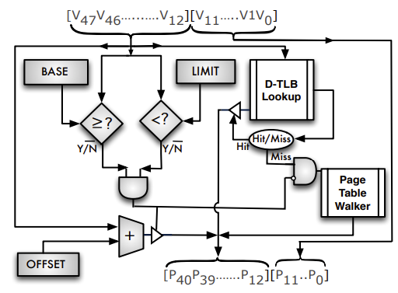
Nested page-walk: Skip translation (Basu’13)
Observation: The overheads of TLB misses is staggering for 4KB and 2MB pages
Insight:
Use some of the physical memory for contiguous memory segments
Allow direct translation gVA->hPA

Slide 60
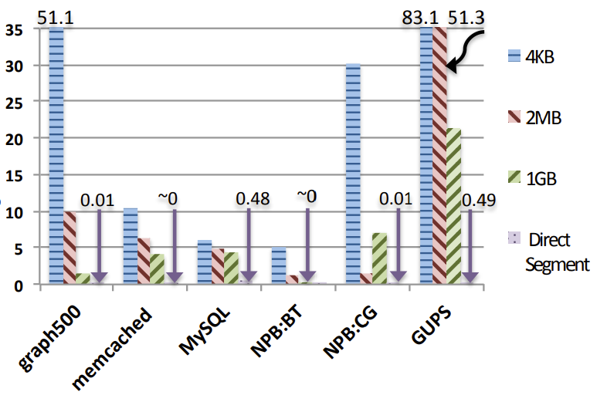
Nested page-walk: Skip translation (Basu’13)
Observation: The overheads of TLB misses is staggering for 4KB and 2MB pages
Insight:
Use some of the physical memory for contiguous memory segments
Allow direct translation gVA->hPA
Benefits:

Slide 61
Nested page-walk: Skip translation (Basu’13)
Pros:
Observation that memory translation in VMs is a real pain
Dramatic reduction in translation overheads
Cons:
Reserving contiguous physical memory impacts hypervisor’s flexibility
Prone to memory fragmentation

Slide 62
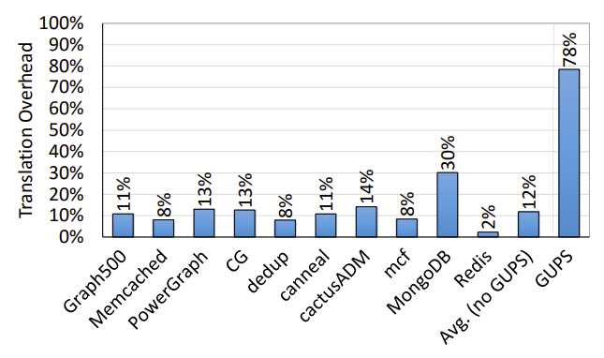
Nested page-walk: Flexible translation (Alam’17)
Observation 1:
Translation is a pain even without virtualization
Native execution, 4KB pages (Haswell)

Slide 63
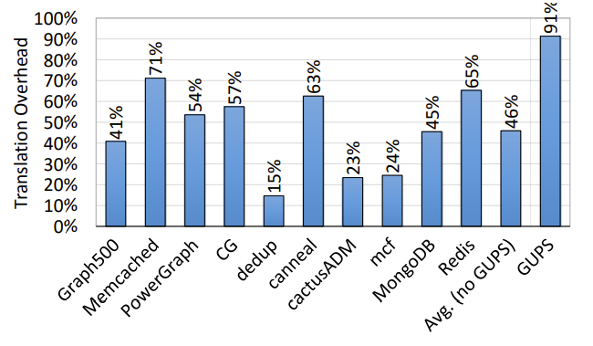
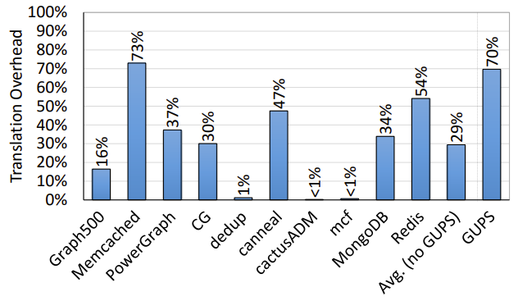
Nested page-walk: Flexible translation (Alam’17)
Observation 1:
Translation is a pain even without virtualization
Gets worse with VMs
4KB pages
2MB pages

Slide 64
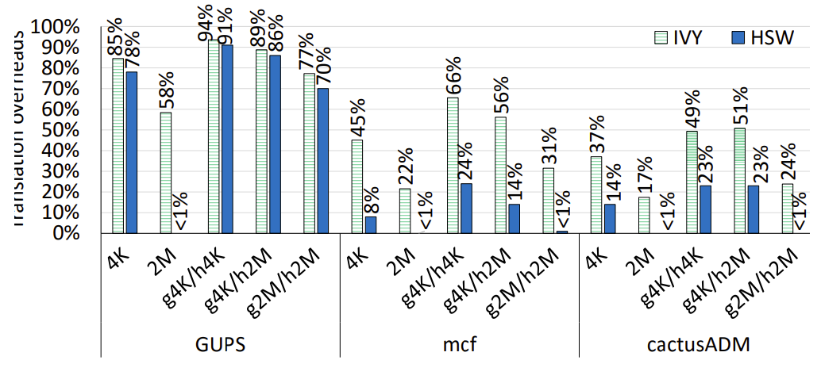
Nested page-walk: Flexible translation (Alam’17)
Observation 1:
Translation is a pain even without virtualization
Gets worse with VMs
Observation 2:
Larger PwCs and L2TLBs help
Translation overhead [%]

Slide 65
Nested page-walk: Flexible translation (Alam’17)
Observation 1:
Translation is a pain even without virtualization
Gets worse with VMs
Observation 2:
Larger PwCs and L2TLBs help
Insight: The Radix tree data structure is not suitable for all applications

Slide 66
Nested page-walk: Flexible translation (Alam’17)
Observation 1:
Translation is a pain even without virtualization
Gets worse with VMs
Observation 2:
Larger PwCs and L2TLBs help
Insight: The Radix tree data structure is not suitable for all applications
Proposal:
Let applications perform memory translation (with some optimizations)
Permissions are checked when translation is inserted to TLB

Slide 67
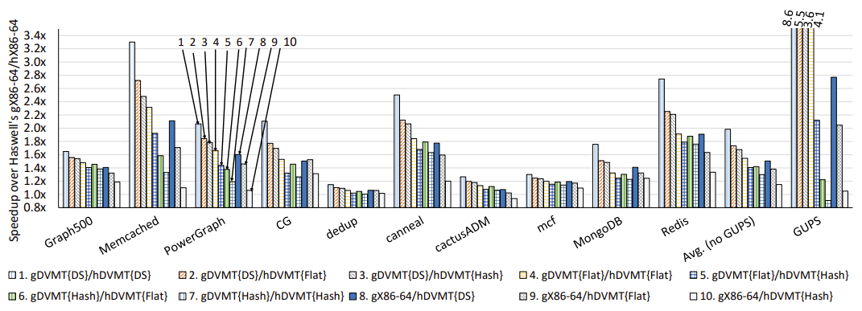
Nested page-walk: Flexible translation (Alam’17)
Benefits (higher is better):

Slide 68
Nested page-walk: Flexible translation (Alam’17)
Pros:
Another demonstration that memory translation (not just in VMs) is painful
Allowing apps to select their own translation data structure is highly beneficial
Cons:
Not trivial to implement
Too many changes to existing systems

Slide 69
Nested page walk: Summary
Virtual memory is an important abstraction, but comes at a cost
Translation consume a large fraction of machine cycles
An active research area with a lot of room for improvement
Part of a bigger problem:
Virtual memory (and other HW/SW abstractions) designed in simpler times
Not a good fit for modern workloads running on manycore CPUs
We need to rethink these abstractions

Slide 70
Thank you ☺
Questions?

